Slide 1

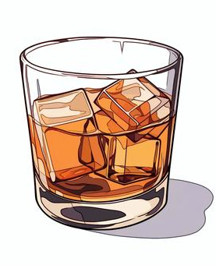
Insurance Applicant Risk Analysis
Predicting applicant smoking and drinking habits based on health markers

Slide 2
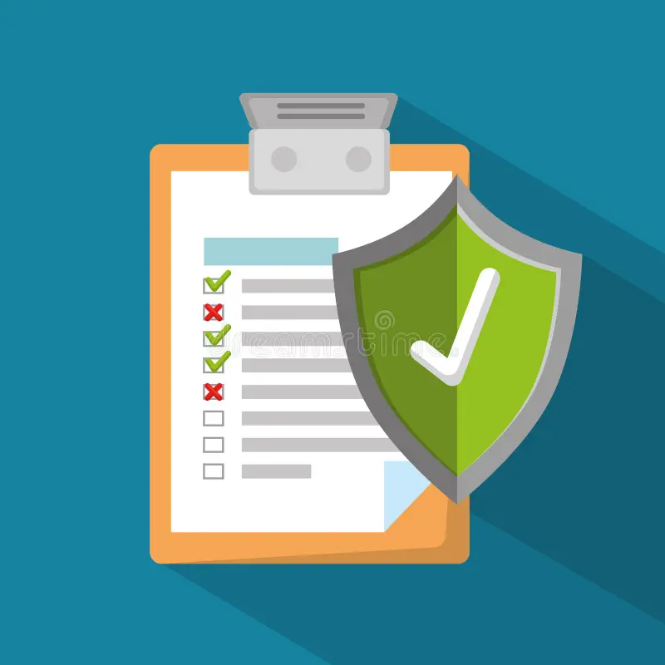
Problem Statement
Underwriting: Insurance firms assess risk to determine premiums and policy terms.
Health Assessment: Evaluates medical history, lifestyle choices (e.g., smoking, drinking), and current health to identify potential risks.
Predictive Need: Applicants might conceal smoking or drinking habits, so firms need predictive tools to accurately assess these risks.

Slide 3



Dataset
Data Source
Variables
Data is from South Korea’s National Health Insurance Service via Kaggle
Includes standard health metrics and indicators like blood pressure, cholesterol, liver, and kidney function
Goal
Goal is to predict drinking and smoking habits and identify key indicators using a subset of 100,000 rows.

Slide 4
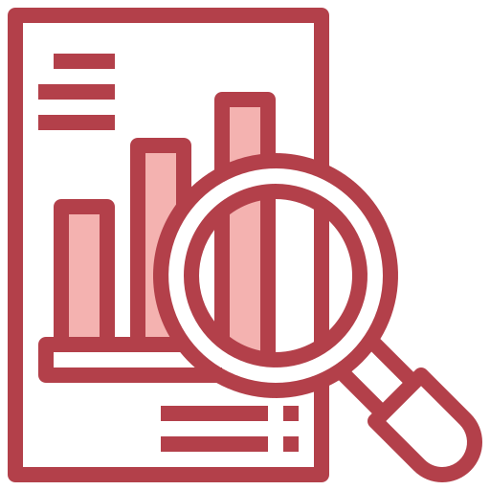



Agenda
Exploratory Data Analysis
Feature Engineering
Pre- Feature Engineering and Post- Feature Engineering Analysis
Features created to improve the accuracy of our prediction
Models Used
Insights and Conclusions
Classification algorithms that we chose for our predictions
Best-fit model for our Dataset and conclusions of the analysis

Slide 5
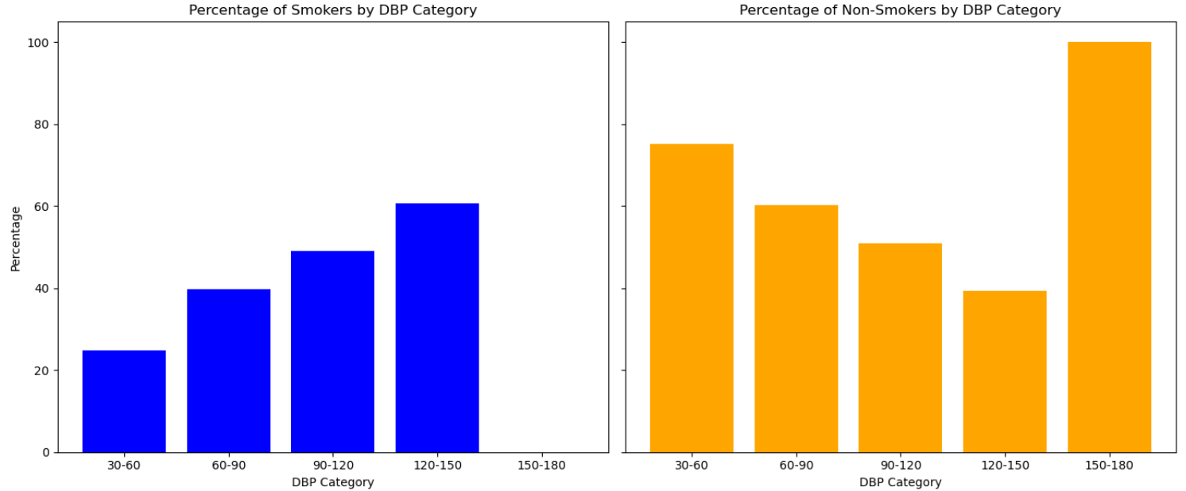
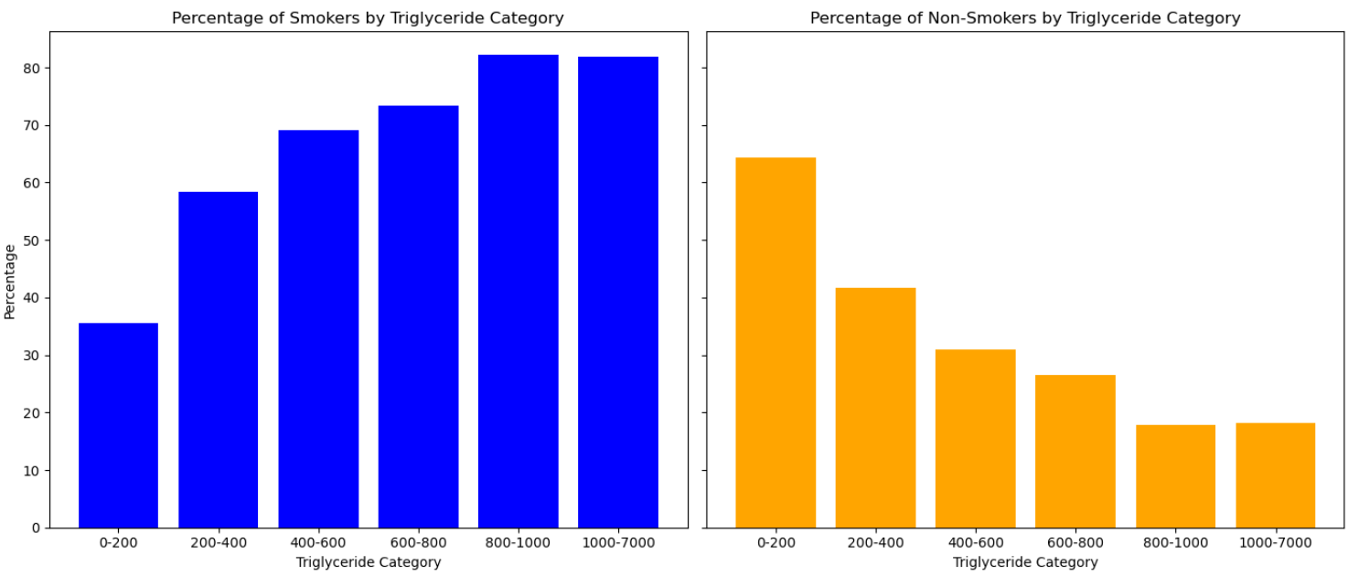
Preliminary Data Analysis and Visualizations
SMOKING

Slide 6
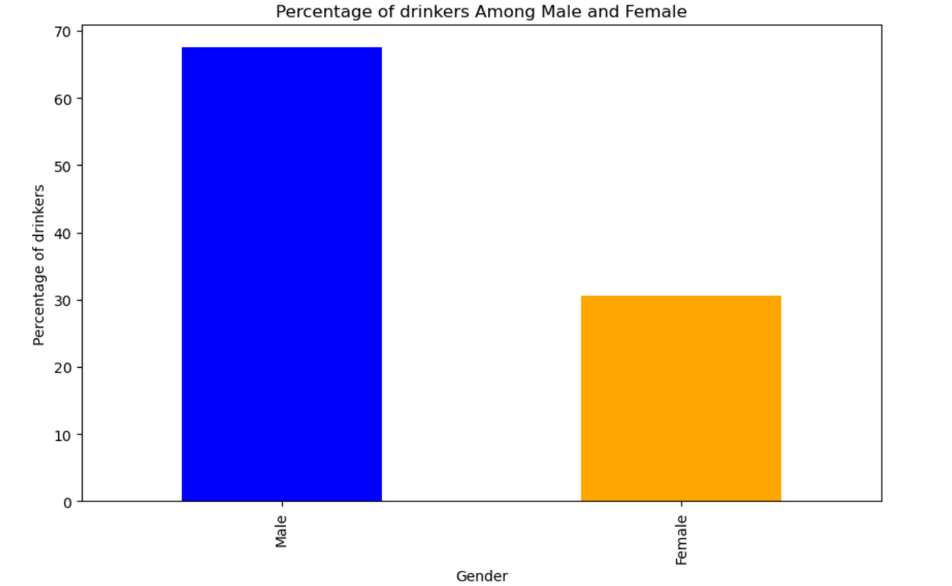
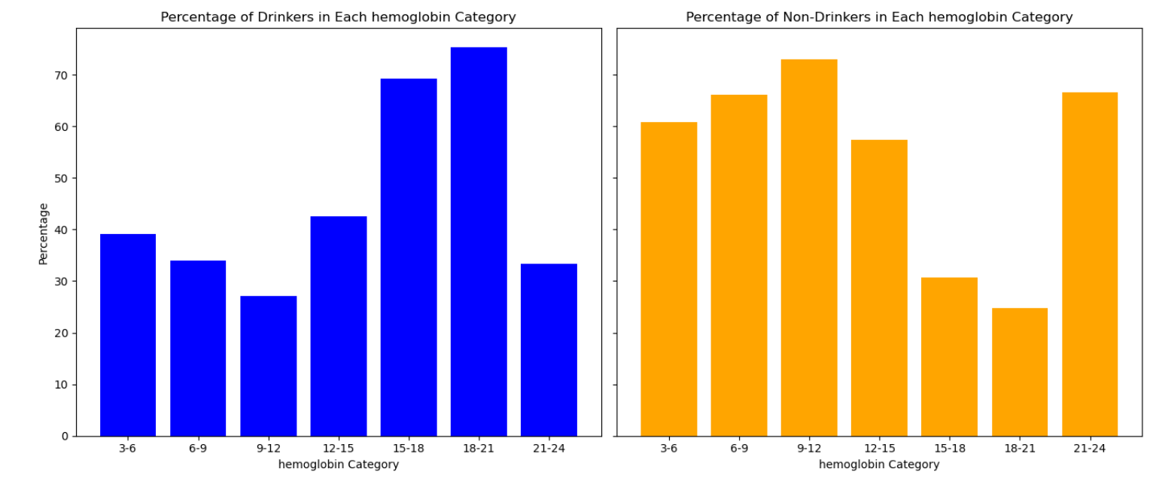
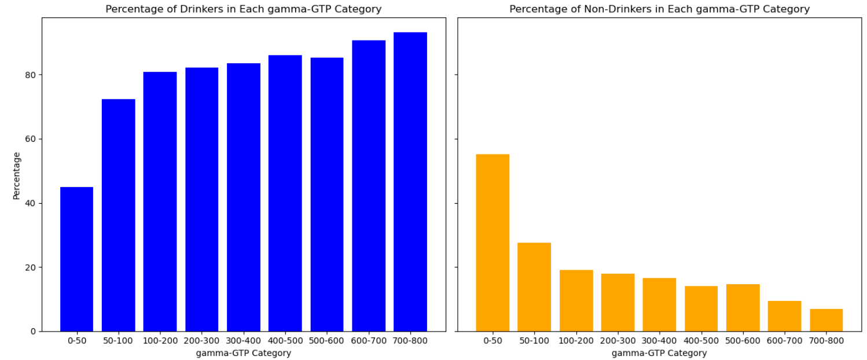
DRINKING

Slide 7
Feature Engineering
Key Variables
Hearing_State | Classifies as faulty if either left/right hearing is faulty
HDL_LDL_Ratio | Ratio of HDL and LDL Cholesterol
BMI | (weight/height^2)
Total_HDL_Ratio | Ratio of Total Cholesterol and HDL
Liver_Enzyme_Ratio | SGOT_AST/ SGOT_ALT
Liver_damage_score | gamma_GTP + SGOT_ALT
Smoking_Status | Factorised smoking status - 0/1
Drinking_Status | Factorised drinking status - 0/1

Slide 8
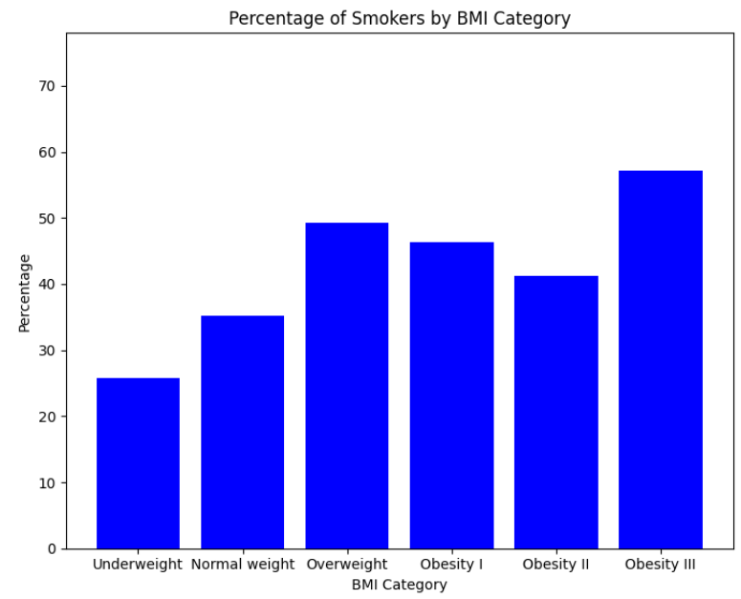
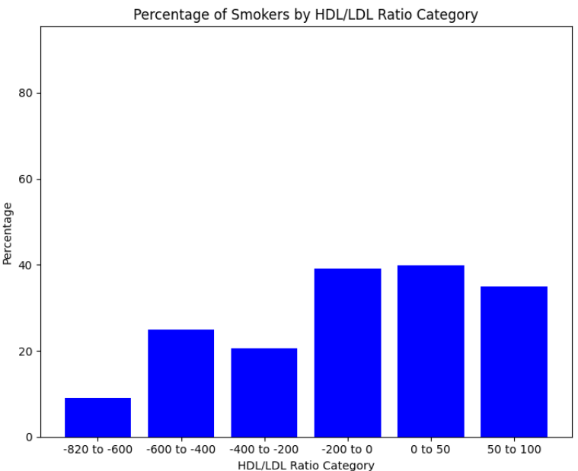
Post-Feature Engineering Analysis SMOKIN
SMOKING

Slide 9
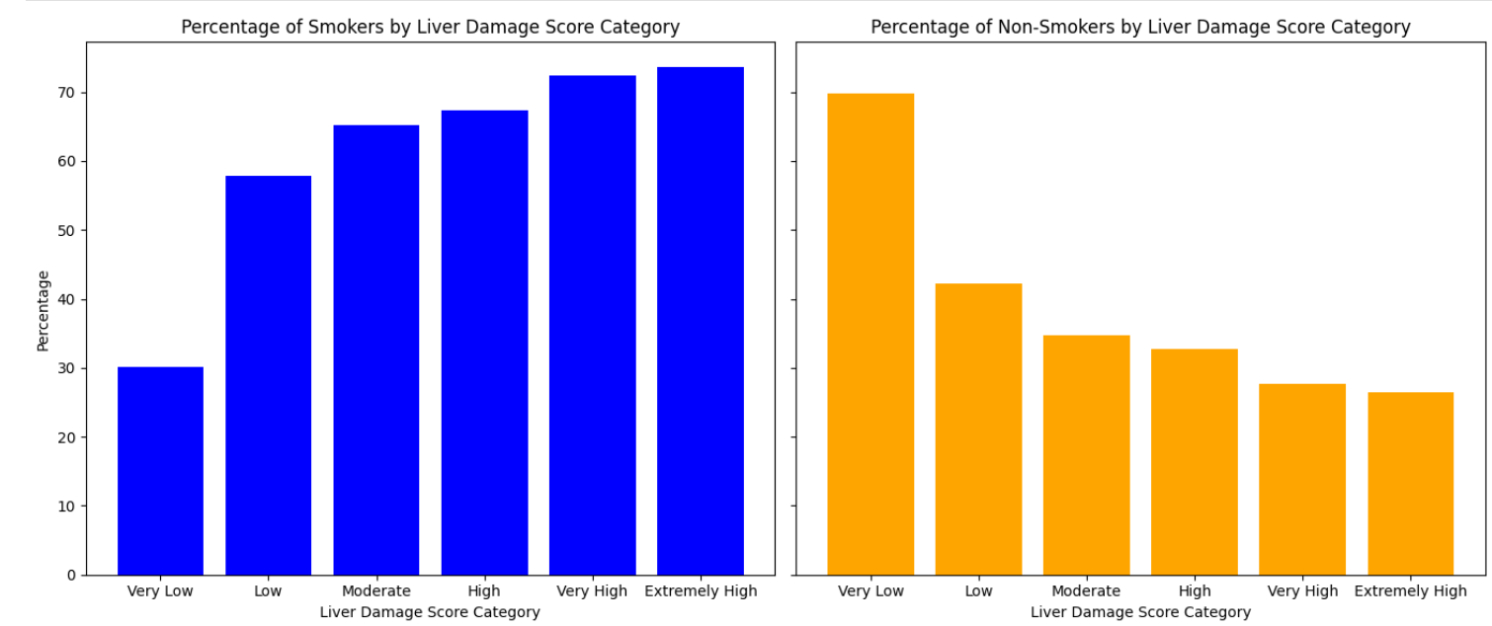
DRINKING

Slide 10
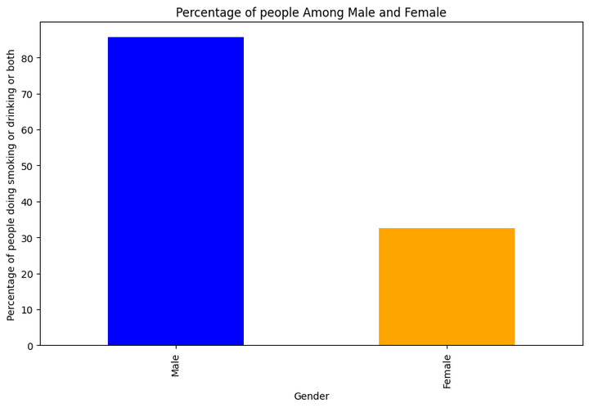
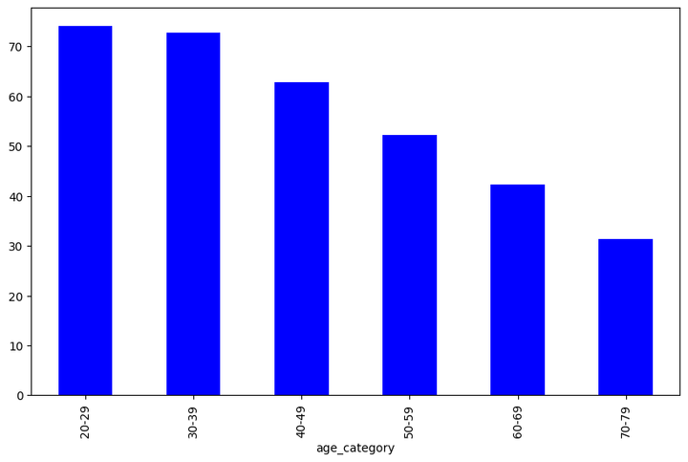
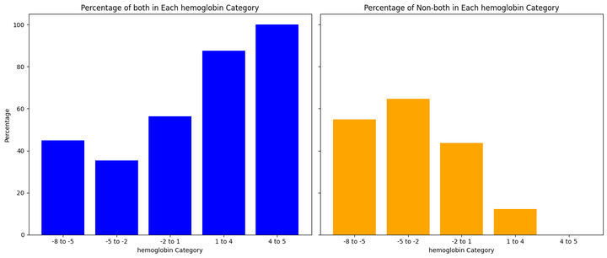
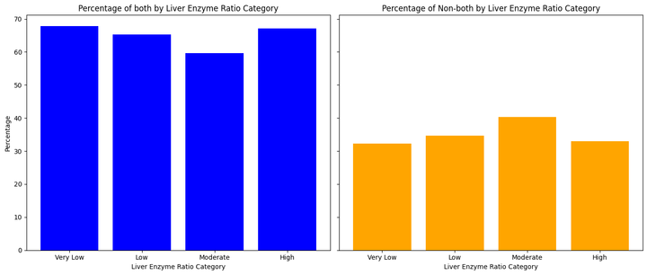
Combination: Smoking and Drinking

Slide 11
Insights
Smoking and drinking behaviors show a sharp increase in likelihood between ages 20 and 30, with a significant decline after 45, likely due to lifestyle changes and increased responsibilities.
Hemoglobin levels are notably higher in smokers and drinkers, while liver damage scores are significantly elevated in drinkers compared to non-drinkers.
There is a high conditional probability that individuals who smoke are also likely to engage in drinking behavior.
Smokers and drinkers tend to have higher triglyceride levels compared to non-smokers and non-drinkers.

Slide 12
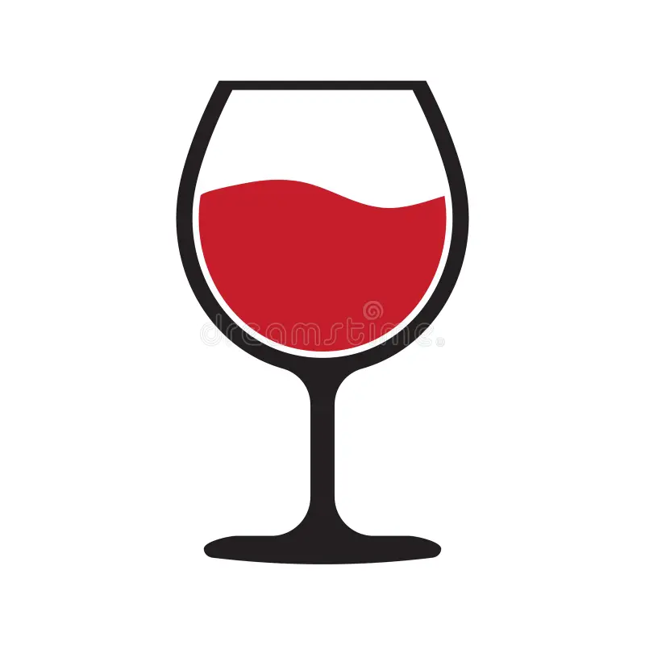
Baseline Accuracy
Drinkers: 50.19%
Smokers: 60.77%
Drinkers and/or Smokers: 60.91%
We assume everyone is a drinker
We assume everyone is not a smoker
We assume everyone drinks and/or smokes

Slide 13
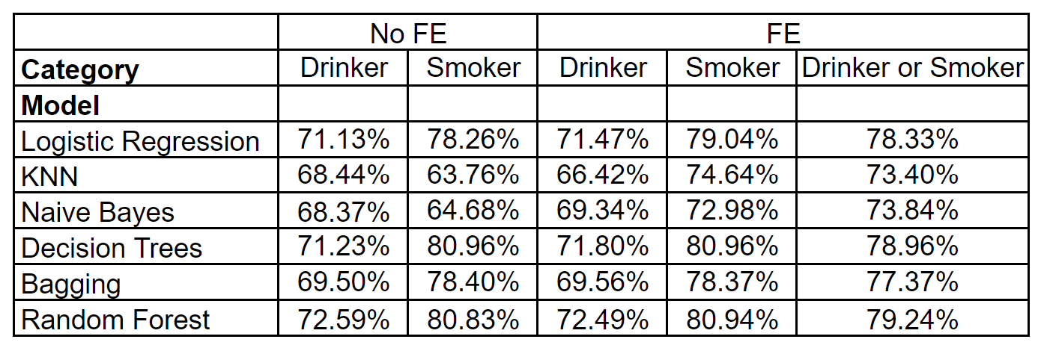
Model Results - Accuracy

Slide 14
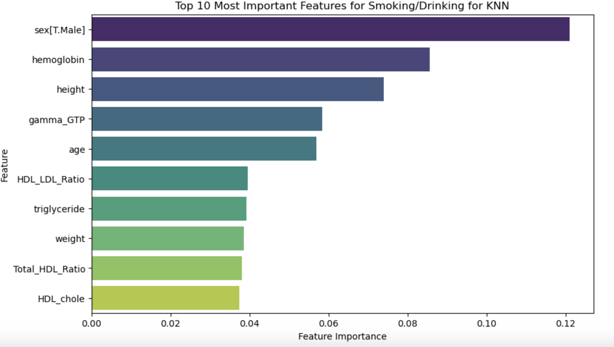
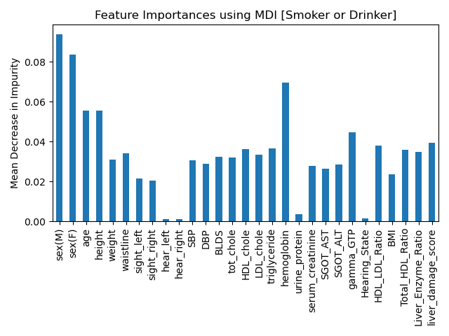
Variable Importance
Age, Hemoglobin, and Gamma-GTP consistently emerged as the most important across all models.
Liver Damage Score and Liver Enzyme Ratio were significant engineered features

Slide 15
Conclusion
Drinkers
Best Model: Random Forest
Improvement over Baseline: 22.40%
Accuracy: 72.49%
Smokers
Best Model: Decision Tree
Improvement over Baseline: 20.19%
Accuracy: 80.94%
Drinker and/or Smoker
Best Model: Random Forest
Improvement over Baseline: 18.33%
Accuracy: 79.24%

Slide 16
Insights
Utilize age, hemoglobin levels, liver damage scores, Gamma-GTP, and liver enzyme ratios to accurately predict smoking and drinking behaviors.
Recognize the high likelihood that smokers also engage in drinking, and integrate this correlation into underwriting models to enhance risk predictions and set more precise premiums.
Adjust premiums and risk management strategies to account for peak smoking and drinking behaviors in younger adults and the subsequent decline observed in older individuals.
Use elevated hemoglobin and liver damage scores as key indicators to refine risk assessments and adjust premiums accordingly.
Shift from relying on self-reported data to leveraging predictive analytics for setting premiums, ensuring fair and accurate pricing based on actual risk profiles.

Slide 18
Thank you!

